Slide 1
IMS Presentation
League of Legends Skin Shop
By Sam White

Slide 2
Introduction to me
Certificate of Higher Education in Computer Science from University of Bristol
Had a strong interest in coding and software development since high school, choosing to take it from GCSE onwards.
Now in week 5 at the training academy as a trainee software developer.

Slide 3
Specification
During my 5 weeks of training at QA Consulting, I have learned various skills that allowed me to create a Inventory Management System in Java. Some of those skills include:
Agile & Project Management
Including SCRUM and Sprints
MySQL
Cloud System
Using GCP to host a VM and an SQL server
Java OOP and SOLID Principles
Continuous Integration using Jenkins, SonarQube and Nexus

Slide 4
Analysis and Design
Used Kanban board hosted on Trello to simulate a sprint
https://trello.com/invite/b/6zr5Bin8/266baefe9a666731eecf40a2ac2455cb/kanban
Created a ERD diagram to help create the database
Update over the course of use as goal was refined
Created UML diagram
which evolved over time as the project matured

Slide 5
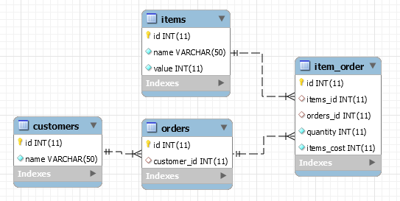

Slide 6
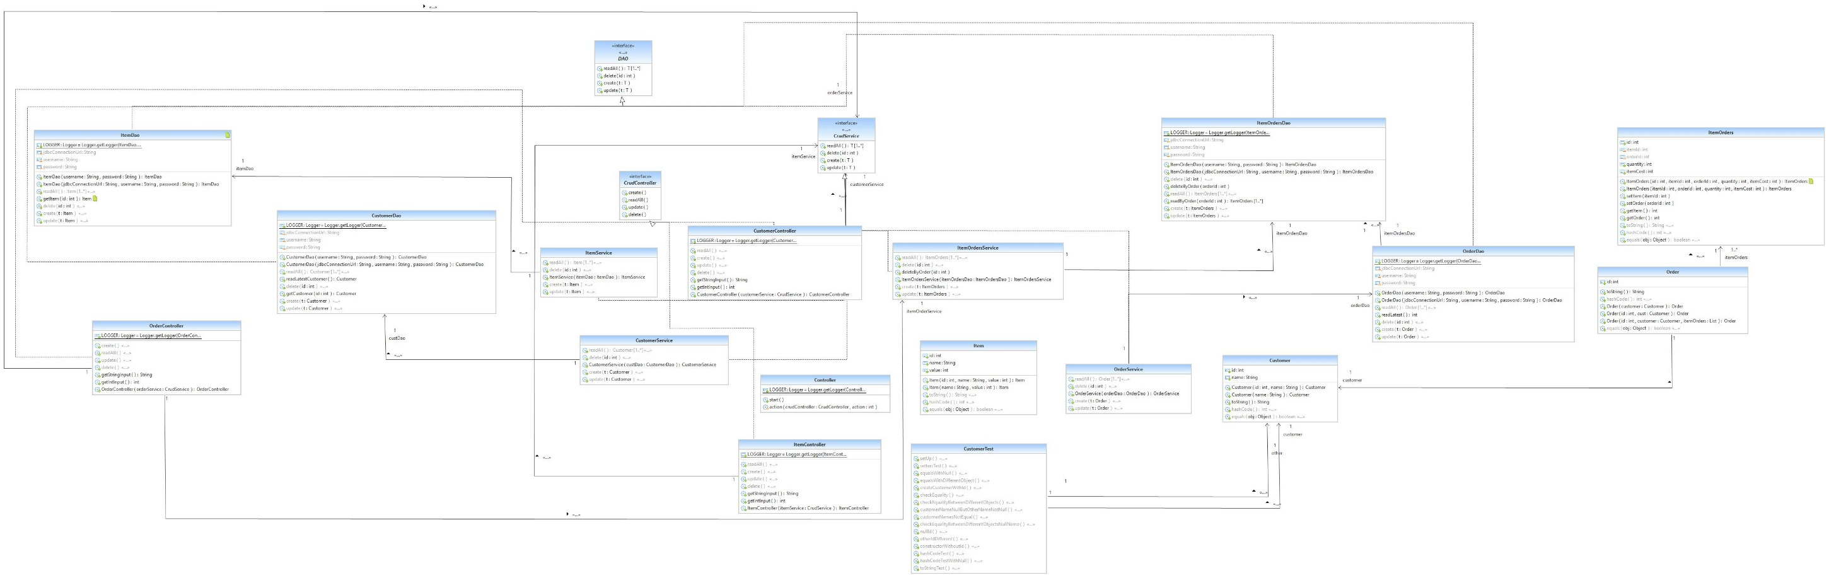

Slide 7
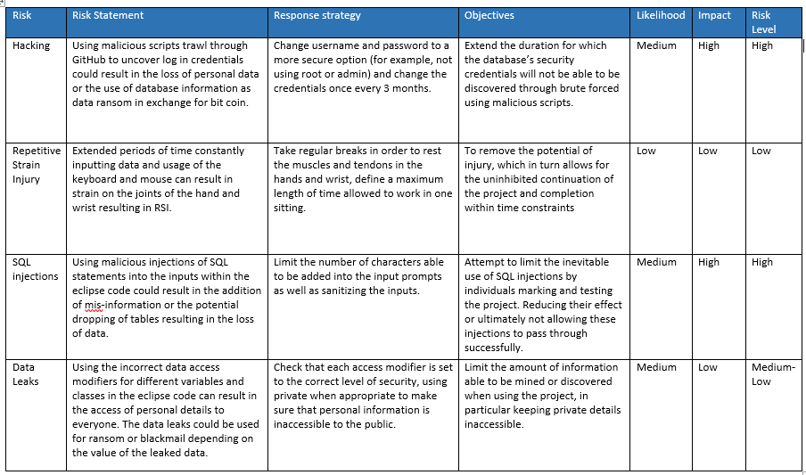

Slide 8
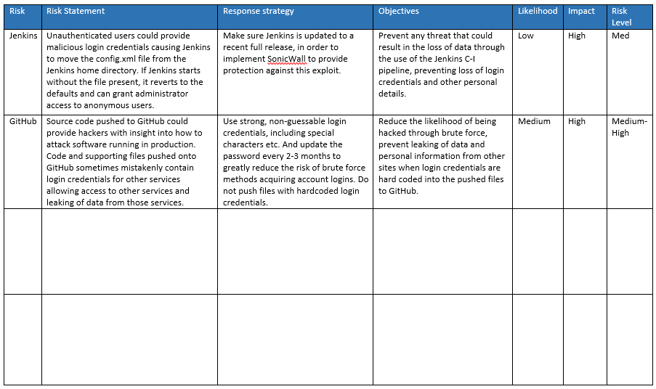

Slide 9
Coding - SOLID
During the design phase, I used OOP and Solid principles to influence how I designed the classes
Single Use – DAO jobs only accessed a single database each
Open/Closed – Used controller interfaces to easily create new controllers without changing their functionality
Liskov’s Substitution principle – In controller class, we pass in a class that extends a interface.
Integration Segregation Principle – Interfaces only have functionality that all implementations of said interface use.
Dependency Inversion – in Item controller, I create an item which is then sent down to the ItemDao which then uses it.

Slide 10
Testing
I used Junit tests to make sure my setters and getters for my database objects were correctly functioning
I also used Mockito to create Integration tests which allowed me to test functions that relied on calling other functions

Slide 11
Automation
I implemented automation into my project firstly through the use of the GCP (Google Cloud Platform) to create a virtual machine instance which hosts the Jenkins CI server.
Jenkins CI server is used to build the IMS whenever there are changes made to the main branch of the GitHub remote repository.
When building, the code is run through SonarQube to check code quality and make sure it reaches a specific quality gate
If it passes the quality gate in SonarQube, then it is deployed to Nexus, which is a Artefact Repository

Slide 12
What would I do differently
I would use a more test driven approach to make sure every segment of code is functionally complete before I move on to the next
I would also prioritise being more agile with development. I spent too much time over large scale changes which is more waterfall style. This made it harder to refactor code
Spend more time working on other aspects of the project rather than investing a lot of time into coding

